Slide 1





Style and Theme Ionic Application
Fauzi Sholichin
fauzisholih@gmail.com
+6289673732142
https://www.linkedin.com/in/fauzisho/

Slide 2
Introduction
Setting global Sass variables
Defining style configuration properties
Setting specific styles
The foundation to build your customized application.
How to use the built in CSS utilities to assist with many of he common layout needs

Slide 3
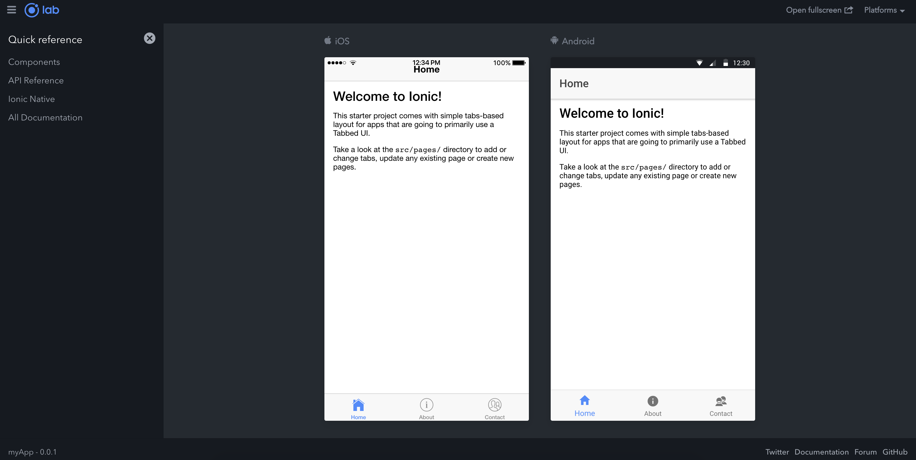
Introduction ionic lab

Slide 4
Setting App Theme Light/Dark
To change it to dark, we'll visit /src/theme/variables.scss and at the bottom, we simply change:
// From
@import "ionic.theme.default";
// To
@import "ionic.theme.dark";

Slide 5
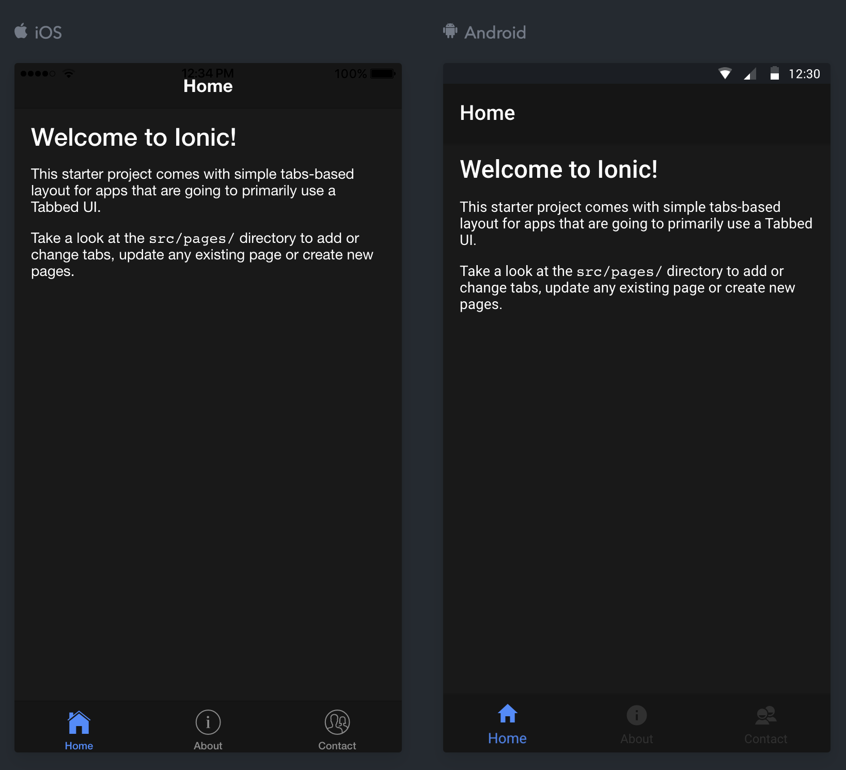
Theme Dark

Slide 6
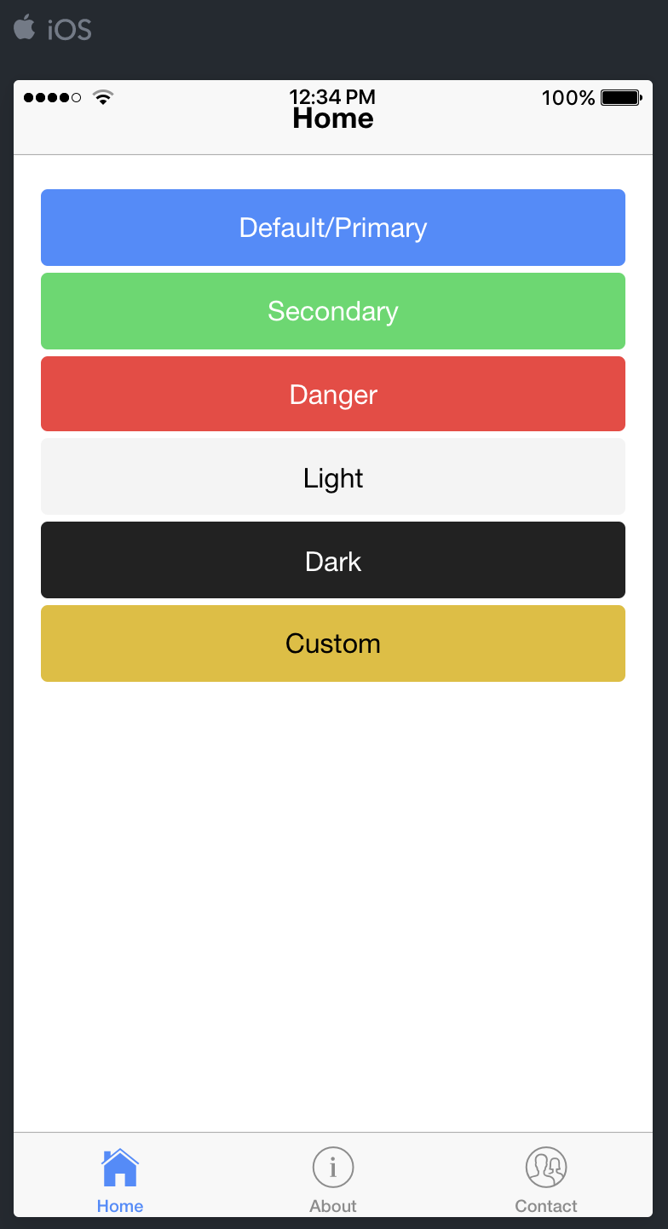
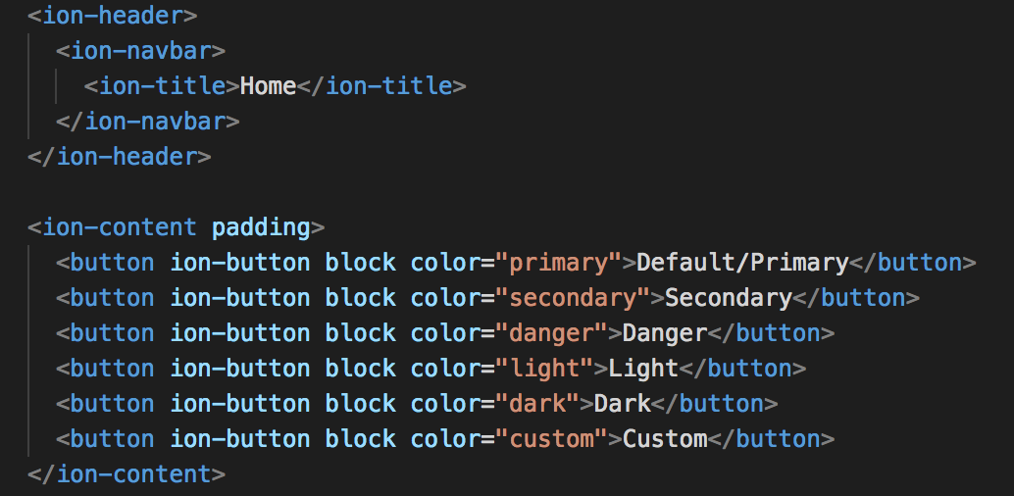
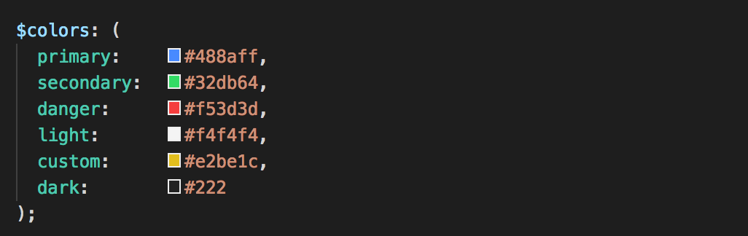
Customize Ionic Default Theme Colors
home.html
variables.scss

Slide 7



Customize Ionic Default Theme Colors
variables.scss
Notes:
If we want more control, we can combine the colors further
by setting the base color and its contrast color.
We can see the result of the contrast color in how the text is colored in each button.

Slide 8
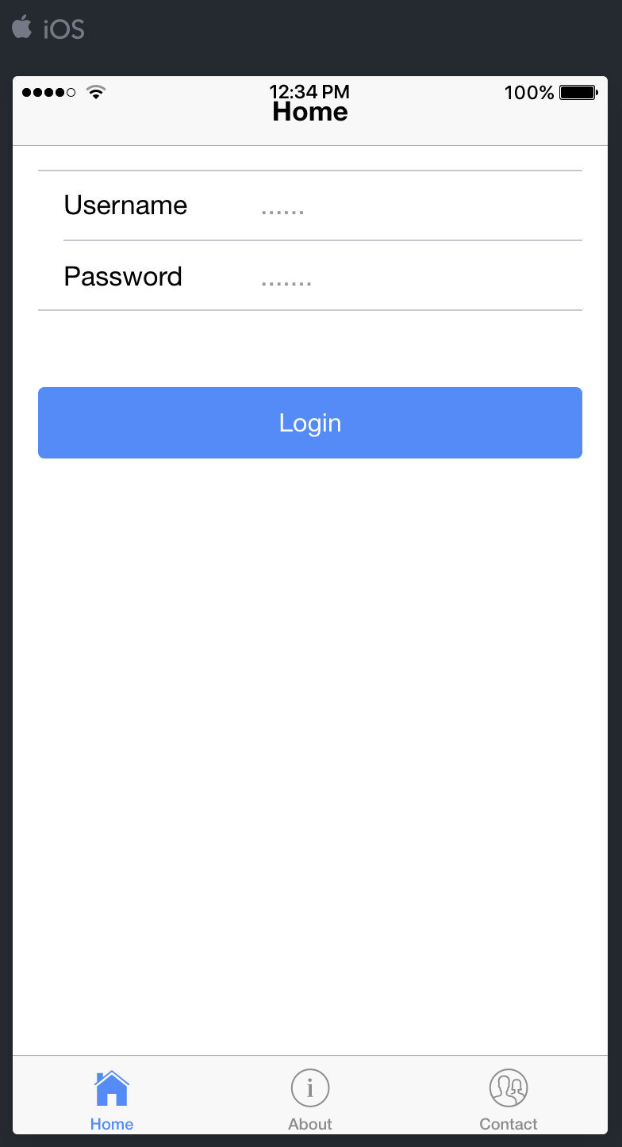
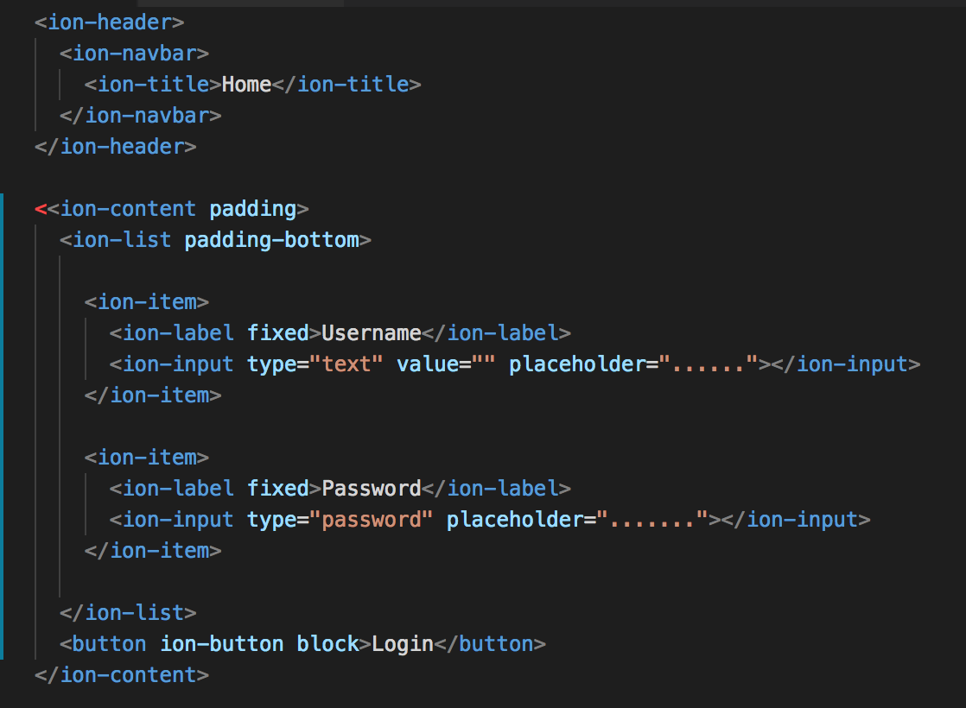
Override Global SASS Variables in Ionic Applications
home.html
Notes:
When styling Ionic components, it's best to see if there is an existing SASS variable that you can set directly.
Here, we have the basics of a login form. Two inputs and a login button.

Slide 9
Override Global SASS Variables in Ionic Applications
As you can see, the alignment of the two inputs
does not match the left edge of the button.
Notes:
When styling Ionic components, it's best to see if there is an existing SASS variable that you can set directly.
Here, we have the basics of a login form. Two inputs and a login button.

Slide 10
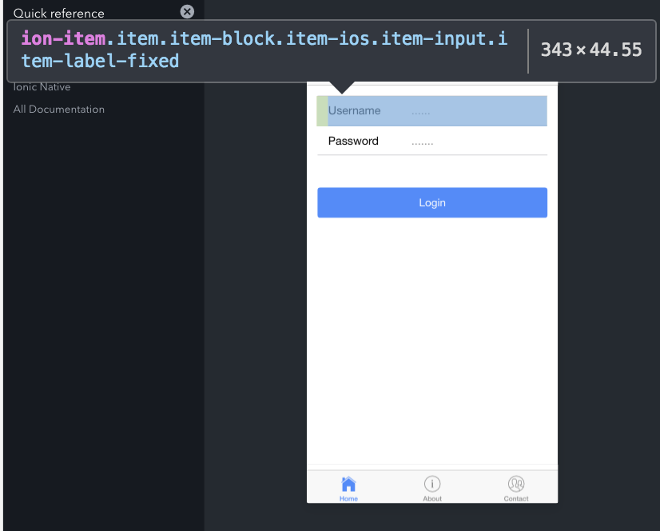
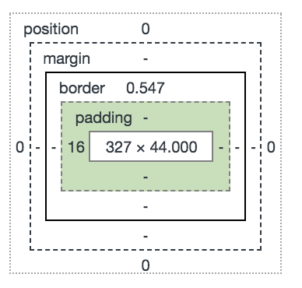
Override Global SASS Variables in Ionic Applications
Open Inspect Element
Select an element in this page to inspect it
Notes:
To move the inputs over, we need to understand what is causing them to be shifted to the right. Opening Chrome's dev tools and using the elements inspector, we can select each of the DOM elements until we find the ion-item that is introducing the padding-left that is shifting our inputs over.

Slide 11
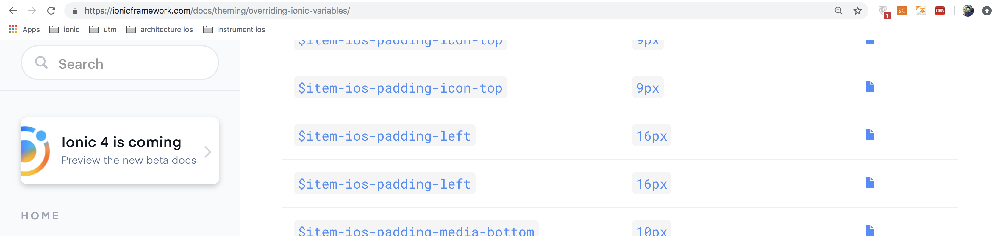
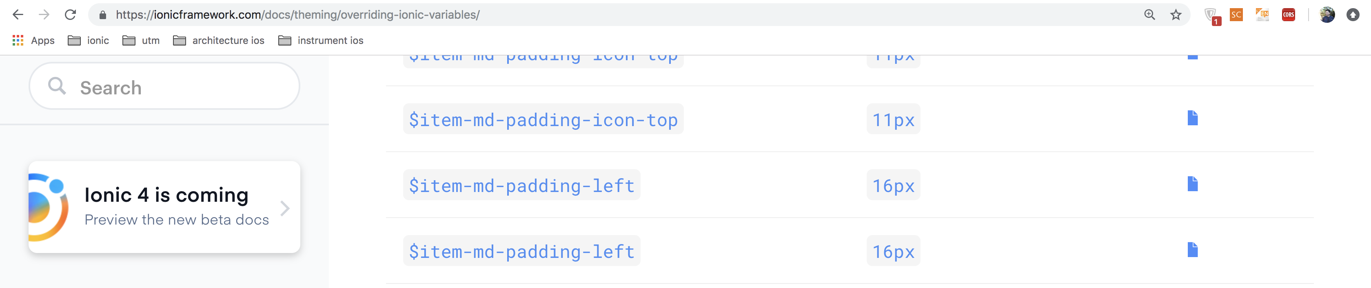
Override Global SASS Variables in Ionic Applications
Notes:
Now, we could directly override these values, but I want to change this value globally in my application. To do this, first I'm going to see if the Ionic framework has exposed a SASS variable for this attribute.
If you go to the API section for that component, there is a listing of some of the SASS variable to use for that component. Since I do not see anything about padding or margins, I'm going to navigate over to the overriding SASS variables page.
This page contains a listing of all the SASS variables used in Ionic.
I'm going to search on item-md. This list new filters the variables for us. There's the exact name of the SASS variable we need, item-md-padding-left. The iOS-specific value would be item-ios-padding-left.

Slide 12
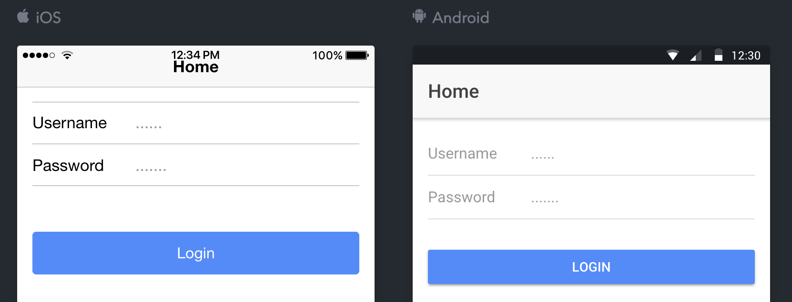
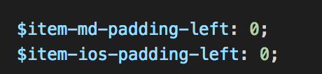
Override Global SASS Variables in Ionic Applications
variables.scss

Slide 13
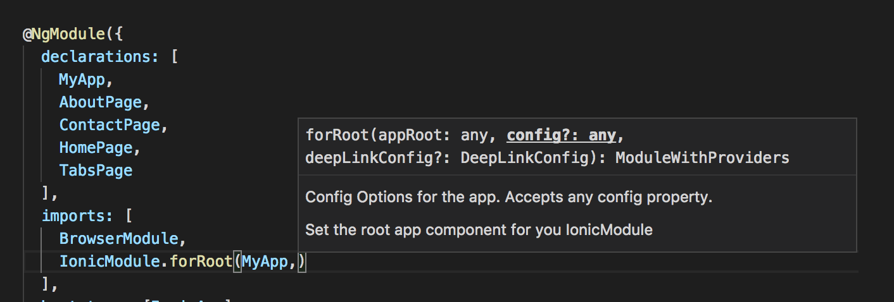
Set Ionic Config Parameters
app.module.ts

Slide 14
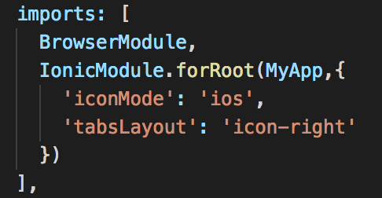
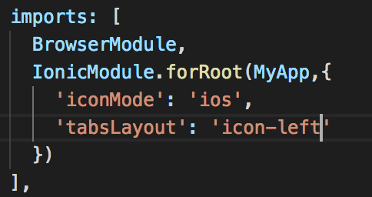

Set Ionic Config Parameters
app.module.ts

Slide 15
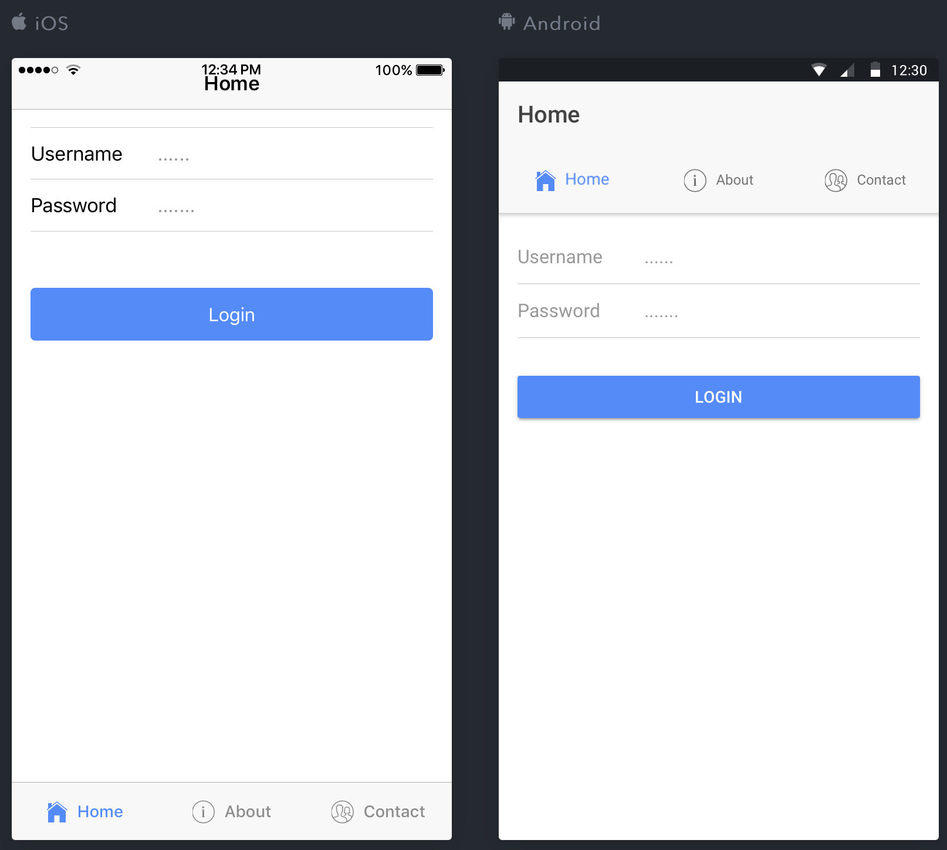
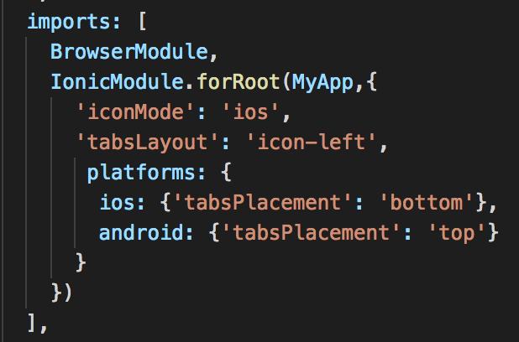
Set Ionic Config Parameters
app.module.ts

Slide 16
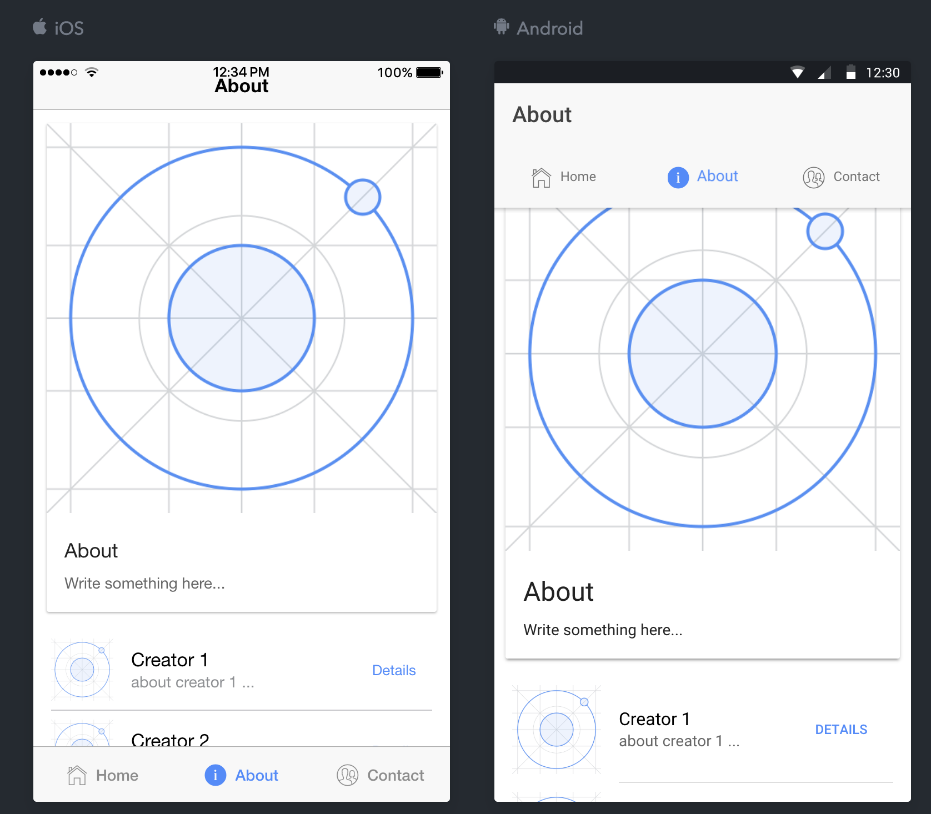
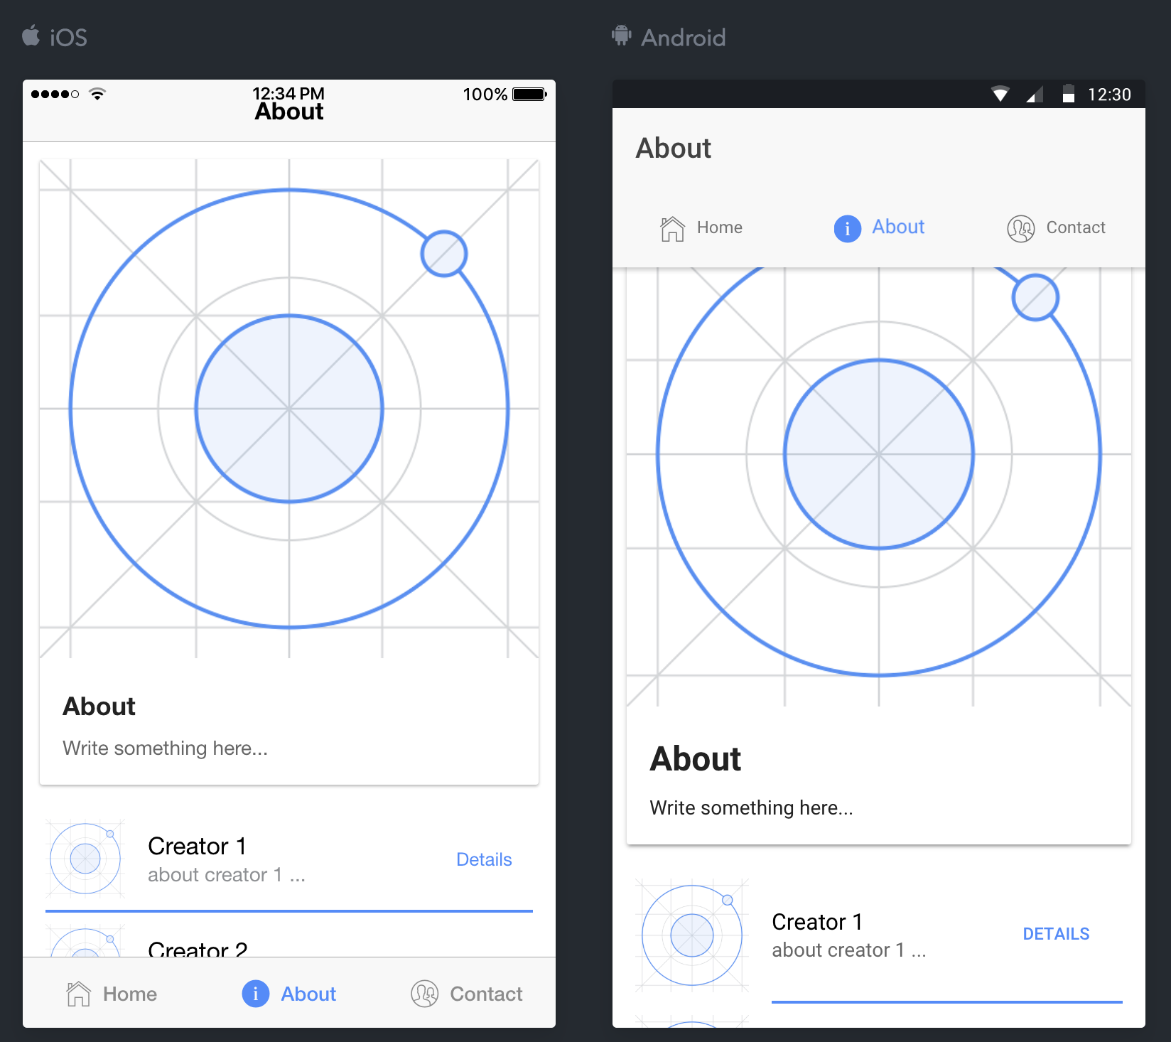
Style an Ionic Component on a Single Page
about.html

Slide 17
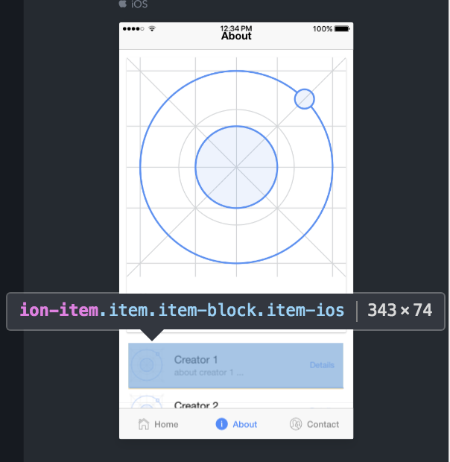
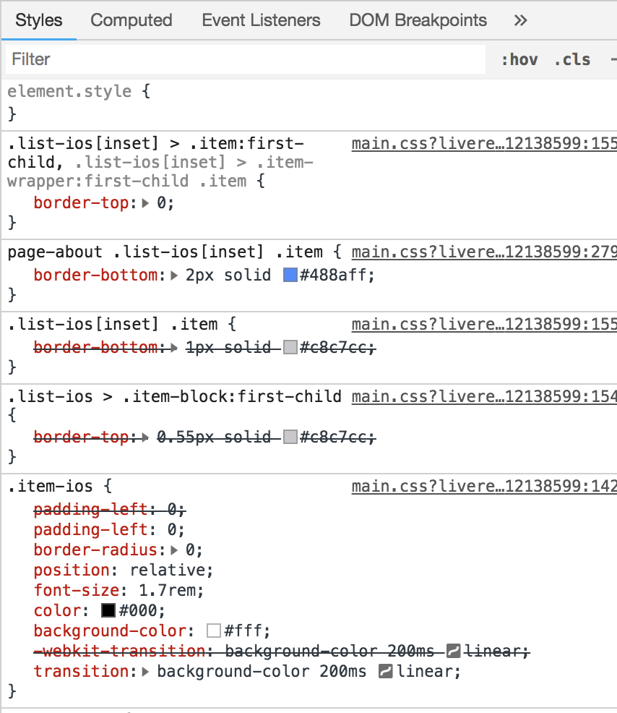
Style an Ionic Component on a Single Page

Slide 18
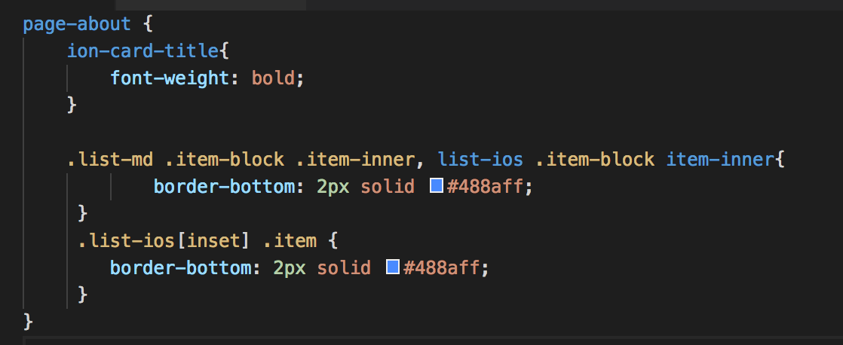
Style an Ionic Component on a Single Page
about.sass

